Slide 1
Common data structures
Implementation and complexity

Slide 2
What’s a data structure?
(Wikipedia) “a collection of data values, the relationships among them, and the functions or operations that can be applied to the data”
an abstraction of data that is easy for a programmer to work with
contains more than data: the data is organized in a specific way
well-defined operations can be applied to the data
→ it is important to know what data structures exist and which
operations can be applied on them

Slide 3
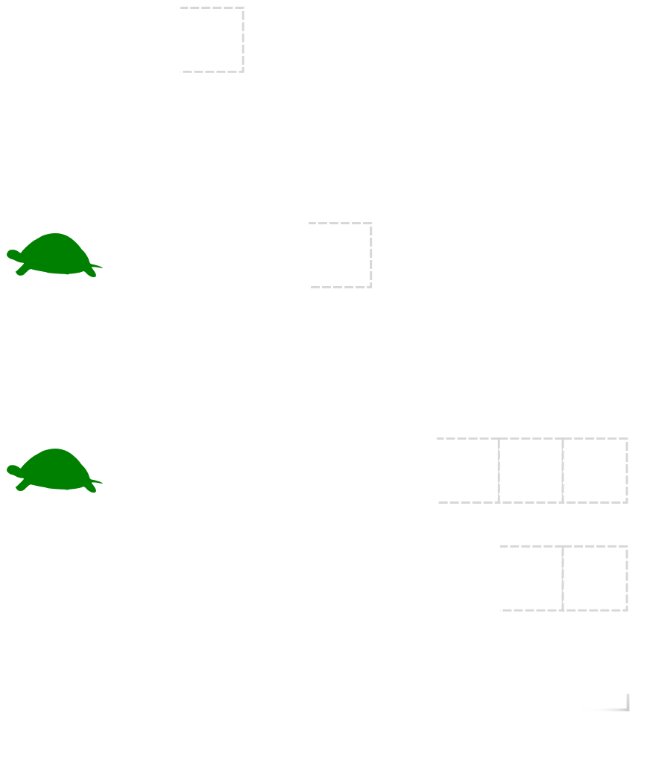
Dynamic arrays (Python lists)
Goal: quickly access indexed items in a container and append new ones (or remove the last one)
Implementation:
the language uses more room than needed
while there is room, appending costs nothing
when there is no more room, create a new array with more room and copy everything

Slide 4
Dynamic arrays (Python lists)
What’s the complexity of adding a new item?
if you reach the capacity c₁ and extend the size to c₂ = 2 * c₁, the cost is c₁ only once but then the cost will be const for the next c₁ append operations
→ on average, the cost is O(1)
What’s the complexity of accessing an item?
O(1), position in RAM deduced from its index

Slide 5
Dynamic arrays: in Python and C++
Common operations:
 | Python | Complexity
Access the i-th item | arr[i] | O(1)
Add v at the end | arr.append(v) | O(1) avg O(n) max
Insert v at position i | arr.insert(i, v) | O(n)
Find the position of v | arr.index(v) | O(n)
When to use:
There are all kinds of use cases. If you often need to perform operations that are not O(1), check if another data structure matches your needs

Slide 6
Quick implementation cheat sheet - Python array
 | Instruction | Complexity
Create a new one | L = list(), L = [] | O(1)
Access the i-th item | arr[i] | O(1)
Add v at the end | arr.append(v) | O(1) avg O(n) max
Insert v at position i | arr.insert(i, v) | O(n)
Find the position of v | arr.index(v) | O(n)

Slide 7
Quick implementation cheat sheet - Python array
 | Instruction | Complexity
Remove the first item with value x | arr.remove(x) | O(n)
Remove the item at the i-th position | arr.pop(i) | O(n)
Clear the array | arr.clear() | O(n)
Get the number of items | arr.len() | O(1)
Sort | arr.sort(key=function) | O(n*log(n))
Count the number of items with value x | arr.count(x) | O(n)

Slide 8
Stacks & Queues
Queues
append()
pop()
FIFO
append()
Stacks
pop()
LIFO

Slide 9
Quick implementation cheat sheet - Python deque
Python: deque in collections : an implementation of double-ended queue
 | Python | Complexity
Create a deque | dq = deque() | O(1)
Access the i-th element | dq[i] | O(n)
Add v at the head | dq.appendleft(v) | O(1)
Remove the head and put it in v | v = dq.popleft() | O(1)
Add v at the tail | dq.append(v) | O(1)
Remove the tail and put it in v | v = dq.pop() | O(1)

Slide 10
Double-ended queues - usage
When to use:
Whenever you need a queue
=> When you need to add and delete element often (from head or tail)
When not to use:
if you want to access very often elements in the middle of the sequence
you don’t need it when inserting and removing elements only on one side (e.g a a stack). Just don’t do that on the left side

Slide 11
Dictionaries / hash maps
Goals:
associate values to keys
retrieve the value associated to a key in O(1) time
→ unlike real-life dictionaries, these ones are not ordered
(in real life, finding a word in a dictionary is O(log n) unless you have forgotten the alphabetical order)

Slide 12
Dictionaries / hash maps
The underlying structure is called a hash table
a hash function turns the keys into an index
the keys and values are stored in the data structure based on this index
multiple strategies exist to manage collisions (cf next slides)(or not)
Example of hash function: sum of the ASCII codes for a string, modulo 42
“hello” → 28 “world” → 6 “INSAlgo” → 33

Slide 13
Dictionaries / hash maps - separate chaining
(key, value) couples where keys have the same hash are stored in a common data structure
These structures are kept small enough to have O(1) time access. When too filled, the table is re-created bigger
Often used:
linked lists
trees
With sum of ASCII codes modulo 8, and using linked lists:
0
1
2
3
4
5
6
7
nyri0
...
algorithms
...
INSAlg0
...

Slide 14
Dictionaries / hash maps - Open adressing
No other data structure behind the array
Collisions are solved with probing
When the fill rate becomes too big, copy the data in a bigger hash table
Linear probing = put at next cell available
Randomized probing: follow a random sequence which seed is given by the hash
→ used in Python
0
1
2
3
4
5
6
7
2
2
6
nyri0
...
algorithms
...
INSAlg0
...
(sum of ASCII codes modulo 8, open adressing with linear probing)

Slide 15
Dictionaries / hash maps - in Python and C++
Python: open adressing with randomized probing (congruential RNG)
initial size 8, resized when ⅔ full
(⊙_◎) ????
Common operations:
 | Python | Complexity
Find or set the value associated to key | dic[key] | O(1) avg O(n) max
Check if key exists in the dictionary | key in dic | O(1) avg O(n) max

Slide 16
Dictionaries / hash maps - in Python and C++
When to use:
Whenever you need to associate a value to a key.
In Python, the ease of use and high performance make the dictionaries a very powerful tool.
When not to use:
When your keys are 0, 1, …, n
You’re better than that.

Slide 17
Quick implementation cheat sheet - Python dict
Python: dict, built in.
Interesting variation : defaultdict in collections
 | Python | Complexity
Create a dict | d = dict(), d = {} | O(1)
Access an element | d[key] | Pseudo O(1)
Put an element | d[key] = value | Pseudo O(1)
Find if a key is in dict | key in d | Pseudo O(1)
Remove a key | del d[key] | Pseudo O(1)

Slide 18
Sets
Goals:
store unique values
quickly check if a value is in the set or not
Two common implementations:
tree-based sets are ordered
hash sets are faster but unordered
(they’re basically hash tables without values)

Slide 19
Sets - in Python and C++
Python: set is a hash set
C++: unordered_set is a hash table, set a tree
Common operations:
 | Python | C++ set and unordered_set | Complexity | Complexity - C++ set
Add the value v to the set | s.add(v) | s.emplace(v) | O(1) avg O(n) max | O(log n)
Remove the value v from the set | s.remove(v) | s.erase(v) | O(1) avg O(n) max | O(log n)
Check if v is in the set | v in s | s.find(v) | O(1) avg O(n) max | O(log n)

Slide 20
Quick implementation cheat sheet - Python set
Python: set, built in : implemented as a hash set
 | Python | Complexity
Create a set | S = set() | O(1)
Access a specific element | IMPOSSIBLE
Put an element | s.add(element) | Pseudo O(1)
Find if an element is in a set | Element in s | Pseudo O(1)
Remove an element | s.remove(element) | Pseudo O(1)

Slide 21
Set arithmetics in Python
 |  | Average complexity
s1 <= s2, s1 < s2 | check if s1 is a [proper] subset of s2 | O(n1)
s1 >= s2, s1 > s2 | check if s1 is a [proper] superset of s2 | O(n2)
s1 | s2 | … | sk | union of s1, s2, …, sk | O(n1 + n2 + … + sk)
s1 & s2 & … & sk | intersection of s1, s2, …, sk | O(min(n1, n2, …, sk))
s1 - s2 | all elements of s1 that are not in s2 | O(n1)
s1 ^ s2 | all elements of s1 or s2 but not both | O(n1 + n2)
Sets too are cool :)

Slide 22
Sets - in Python and C++
When to use:
to mark values already seen
to keep a collection of unordered unique elements
When not to use:
to make coffee (you just can’t)
to keep twice the same element (really, you just can’t)

Slide 23
Bonus : data structures to store Graphs
Two main possibilities:
Adjacency matrix
Adjacency list
Let’s see the result on this graph :
1
0
2
1
0
3
2
3

Slide 24
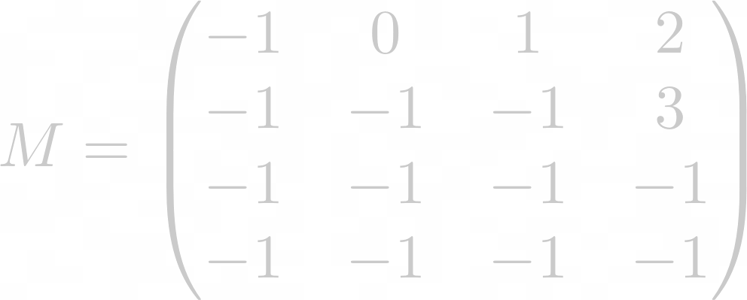
Adjacency Matrix
1
0
2
1
0
3
A matrix where each element a_{ij} give the cost of the
edge between node i and node j.
The value of a_{ij} = -1 if there is no edge between i and j
For the example graph, we have:
2
3
When to use it ?
When we need to check if two random nodes are linked

Slide 25
Adjacency List
1
0
2
1
0
3
For each node, give the list of all adjacent nodes (and the weight of the edge linking them)
Can be implemented with lists or dictionary depending on the indexing of the nodes
For the example we get :
2
3
0 | 1 | 2 | 3
[(2,1), (1,0), (3,2)] | [(3,3)] | [ ] | [ ]
When to use it ?
When we need to know the nodes reachable from a current node

Slide 26
Python - python.collections classes
A default Python module
collections.defaultdict(default_factory) : if an element doesn’t exist, create it using the default_factory function
collections.orderedDict : a dict which remembers the order of creation of its elements
collections.deque : an implementation of a double-ended queue
collections.Counter : counts occurrences in a list

Slide 27
To be continued...
You probably want to hear about red-black trees, heaps (priority queues), etc…
Any questions ?
Slides: Louis Sugy, Arthur Tondereau for INSAlgo.
Updated by Louis Gombert and Sebastien Goll
Schema of dynamic arrays: Wikipedia
Useful links:
https://docs.python.org/3/tutorial/datastructures.html (data structures overview)
https://wiki.python.org/moin/TimeComplexity (Time complexity for most operation)
https://docs.python.org/3/library/collections.html (Collections library)

